Slide 1
JavaScript – jQuery
Instructor: Manu Peethambar
E-mail: cm13055@umbc.edu
Telegram handle: @manupeethambar888
Slides: https://github.com/manupeethambar888/webdev

Slide 2
jQuery Effects - Sliding
The jQuery slide methods slide elements up and down.
https://www.w3schools.com/jquery/jquery_slide.asp
jQuery Effects - Animation
The jQuery animate() method lets you create custom animations.
https://www.w3schools.com/jquery/jquery_animate.asp

Slide 3
jQuery Stop Animations
The jQuery stop() method is used to stop animations or effects before it is finished.
https://www.w3schools.com/jquery/jquery_stop.asp
jQuery Callback Functions
A callback function is executed after the current effect is 100% finished.
https://www.w3schools.com/jquery/jquery_events.asp

Slide 4
jQuery - Chaining
With jQuery, you can chain together actions/methods.
Chaining allows us to run multiple jQuery methods (on the same element) within a single statement.
https://www.w3schools.com/jquery/jquery_chaining.asp

Slide 5
Assignment 18 due – 7/20/2018
Create a sample html file.
Go to the next slide for the question.
Save this as “assignment18.html” in Homework folder in your GitHub repository “Assignments_yourname”.
Commit and push the changes to the repository.

Slide 6
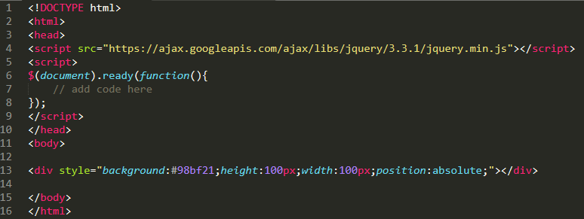
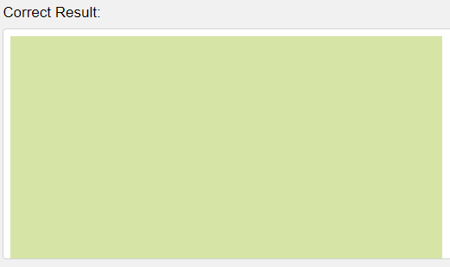
Assignment 18 due – 7/20/2018
Use the animate() method to set the following CSS properties for <div>: opacity: 0.4, height: 500px, width: 500px.

Slide 7
Exam 3 – 7/24/2018 (Tuesday)
Study all slides on JavaScript(JS):
https://github.com/manupeethambar888/webdev
Practice all the concepts taught on www.w3schools.com try it editor.

Slide 8
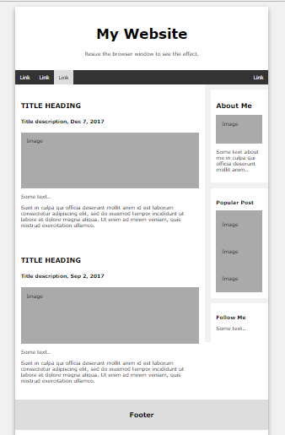
Project Assignment
You have to save the below assignment in your project folder.
Replace the text and fill your relevant information into the elements in index.html
Add relevant images.

